Slide 1
Lecture 1. Computer Architecture & Design Overview (1)
CMPE 200 Computer Architecture & Design
Haonan Wang

Slide 2
About Prerequisite – What to Submit?
If you have 180D in your admission letter
You then need to submit your transcript with 180D highlighted
You cannot take this course before finishing 180D
If you do not have 180D in your admission letter
You then need to submit your admission letter

Slide 3
Abstraction of Computers
CS/SE
CMPE
Software/Applications
Operating System
Compiler
Firmware
CMPE200
ISA
Processor
Registers
Cache
Memory
HDD/SSD
Datapath & Control
Digital Design
Circuit Design
EE/Phys
Semiconductor physics

Slide 4
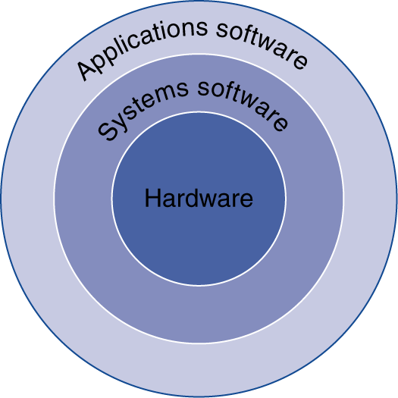
The Software’s Point of View
Application software
Written in high-level language
System software
Compiler: translates HLL code to machine code
Operating System: service code
Handling input/output
Managing memory and storage
Scheduling tasks & sharing resources
Hardware
Processor, memory, I/O controllers, …

Slide 5
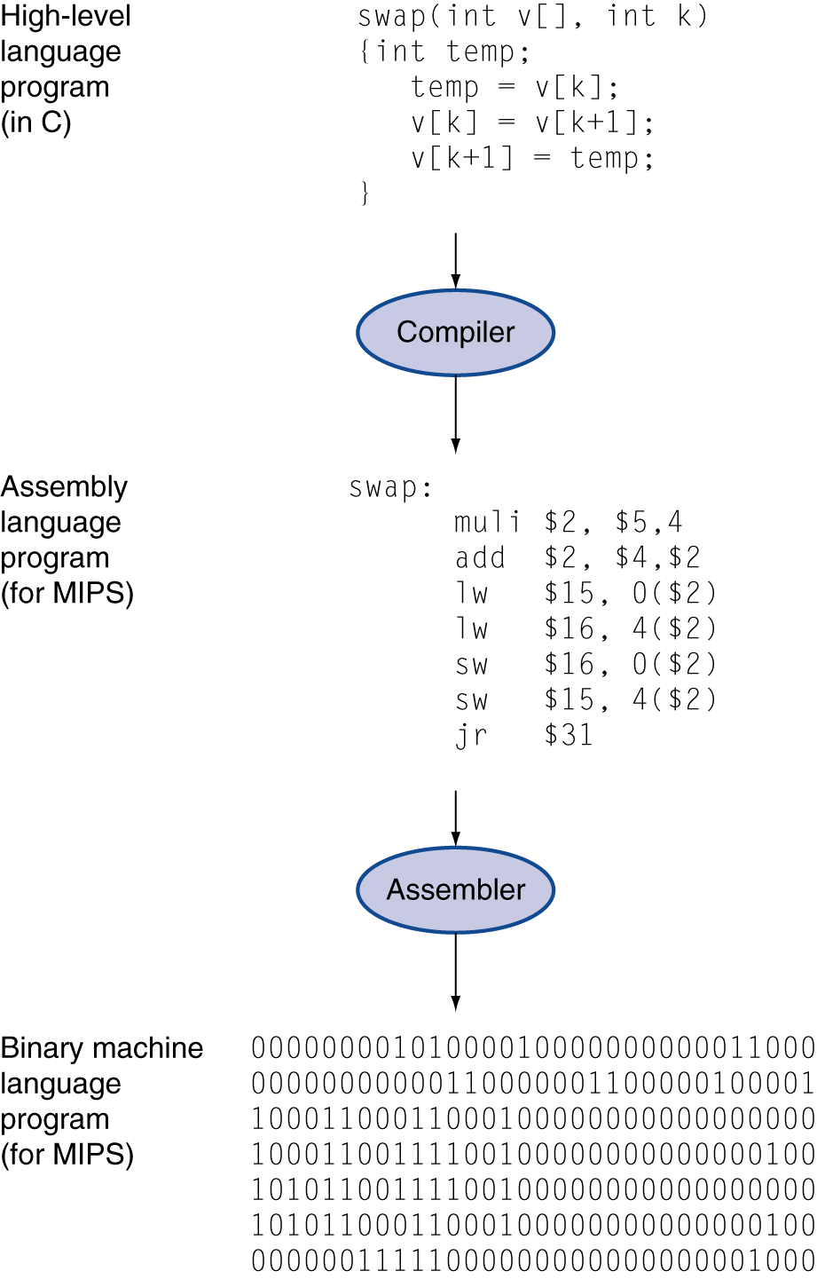
The Codes’ Point of View
High-level language
Abstraction Level closer to problem domain
Provides for productivity and portability
Assembly language
Textual representation of instructions
Hardware representation
Binary digits (bits)
Encoded instructions and data

Slide 6
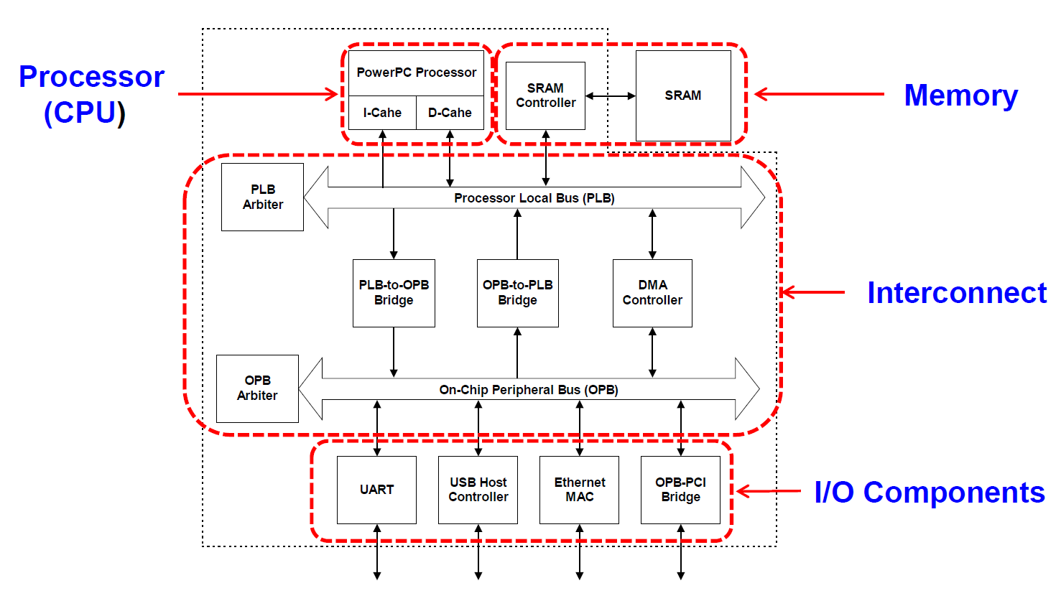
Hardware’s Point of View
Computer Organization:
Nowadays DRAM

Slide 7
Your Thoughts
Try to conclude with as few words as possible:
Computer Organization vs. Computer Architecture
– What is the key difference?
Connection vs. interface

Slide 8
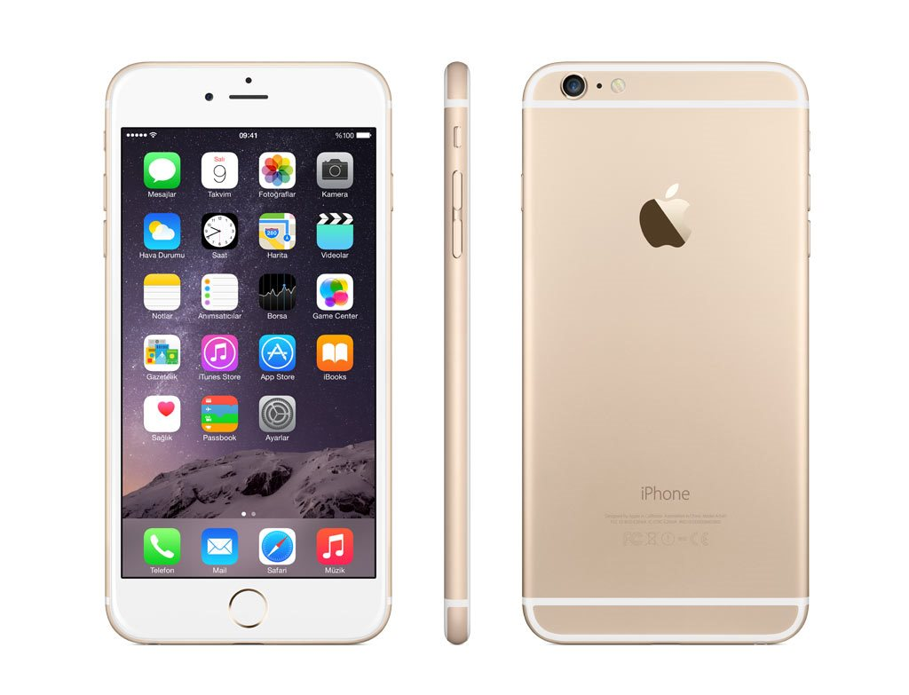
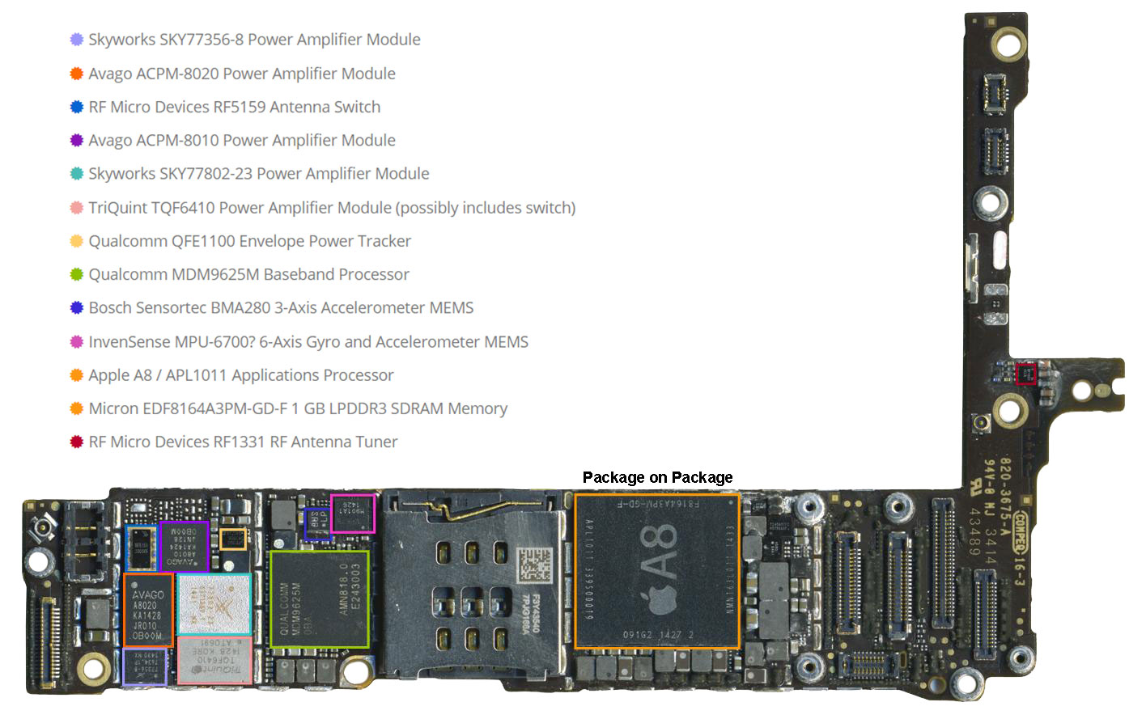
Hardware Examples
Processor
Main memory
(SDRAM)
Figures from http://www.techinsights.com/teardown.com/apple-iphone-6/

Slide 9
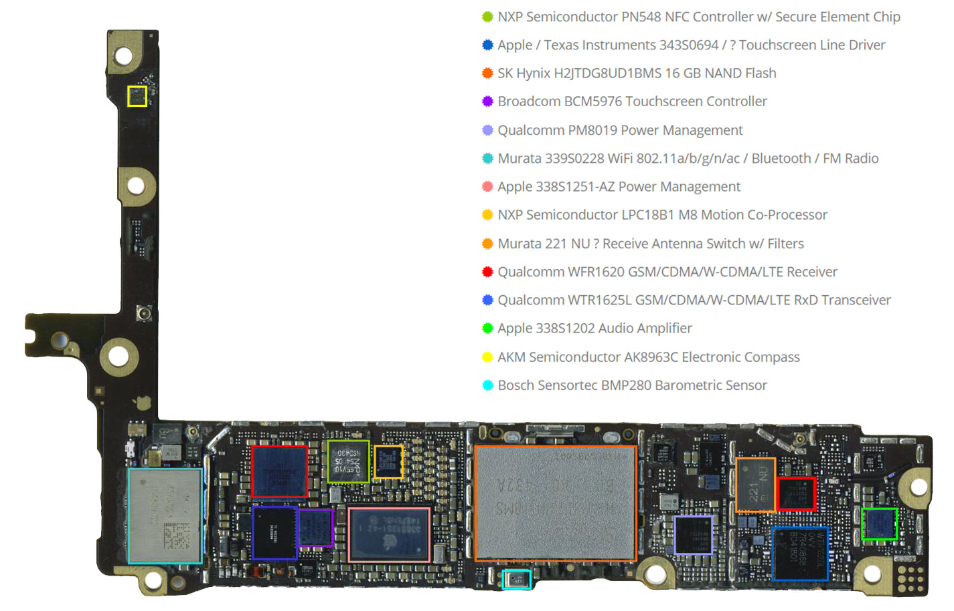
Hardware Examples
Storage
(NAND Flash)
Input/output device
(touch screen)
Figures from http://www.techinsights.com/teardown.com/apple-iphone-6/

Slide 10
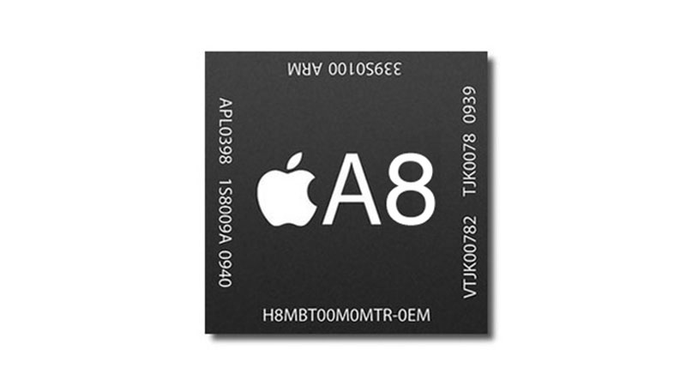
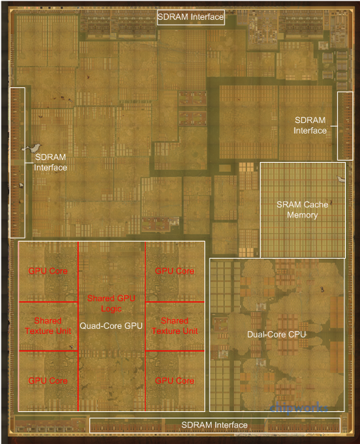
Hardware Examples
What is the advantage of having them in the same package?
Figures from http://www.anandtech.com/show/8562/chipworks-a8

Slide 11


Electronic Components’ Point of view
Transistors
3-terminal device
Gate input: the control input; its voltage determines whether current can flow
Source & Drain: terminals that current flows from/to
Many transistors can be fabricated on one piece of silicon (i.e. an integrated chip, IC)
Gate +5V
Transistor is ‘on’
Source
Drain
-
-
High voltage at gate allows current to flow between source and drain
-
-
-
-
Silicon
Gate 0V
Transistor is ‘off’
Source
Drain
-
-
Low voltage at gate prevents current from flowing between drain and source
Silicon
Integrated Circuit
Actual silicon wafer is quite small but can contain several billion transistors
Silicon wafer is then packaged to form the chips we are familiar with
More transistors = faster core?

Slide 12
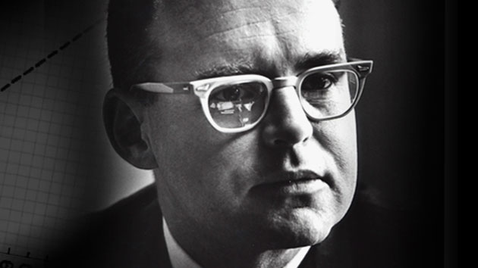
Moore’s Law (1965)
In 1975, he recalibrated it to every two years.
Later, it is recalibrated again to 18 months, as is widely known as Moore’s Law.
“The number of transistors per square inch on integrated circuits had doubled every year since the integrated circuit was invented and this trend would continue for the foreseeable future.”
-- Gordon E. Moore, “Cramming More Components onto Integrated Circuits,” Electronics, pp. 114–117, April 19, 1965.

Slide 13
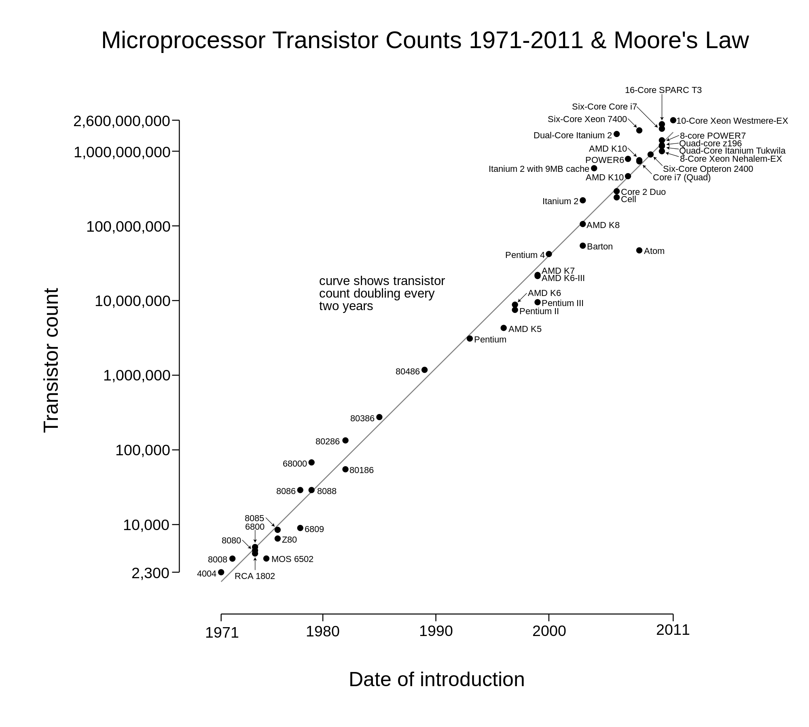
Moore’s Law (1965)
The law has been preserved over four decades..

Slide 14
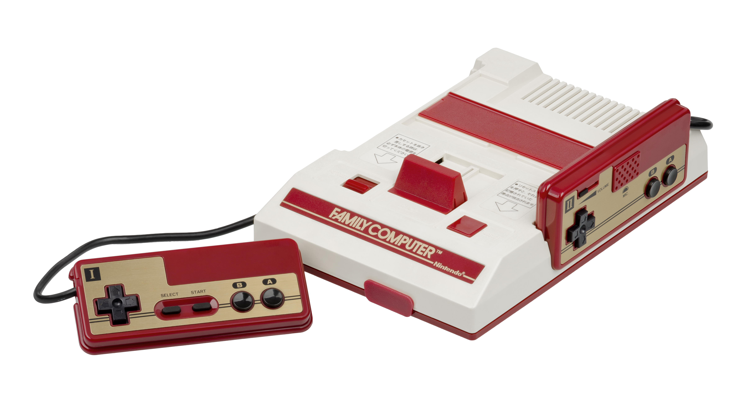

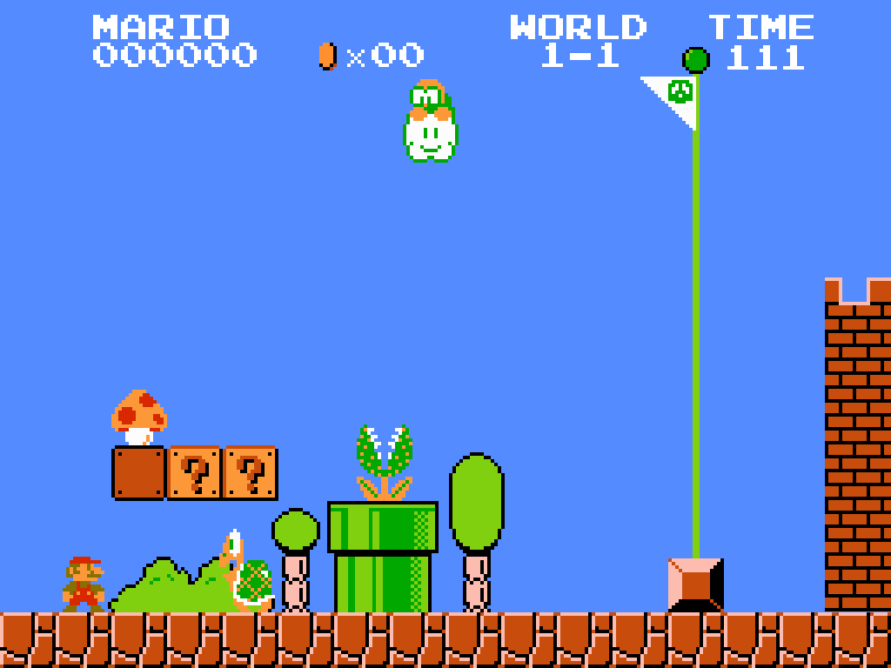



What Does It Enable?
Applications that were impossible to run on the computers before
3D games, Augmented reality, Virtual reality, Deep learning…

Slide 15
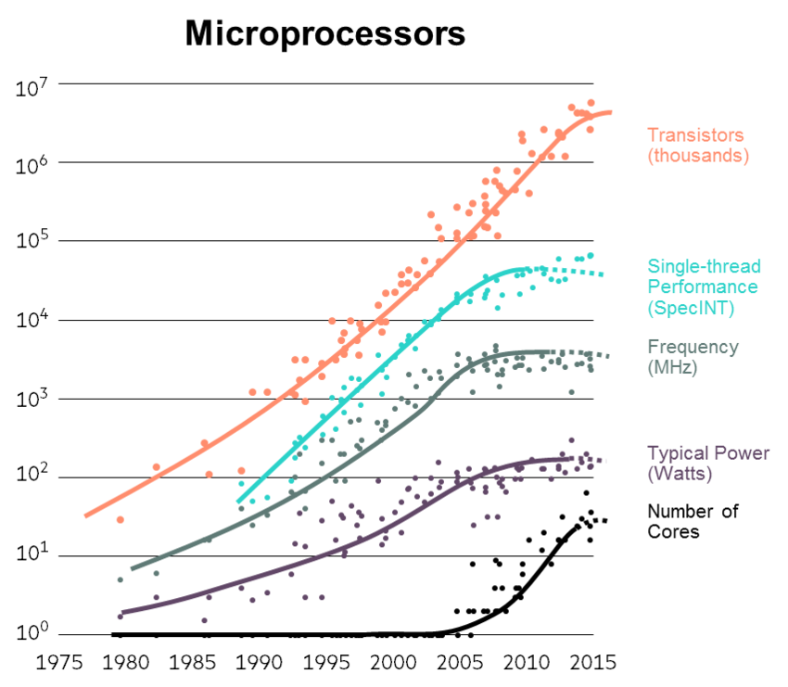
Moore’s Law (1965)
Will it last forever?
Dead?

Slide 16
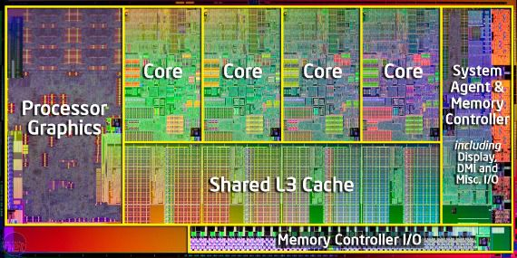
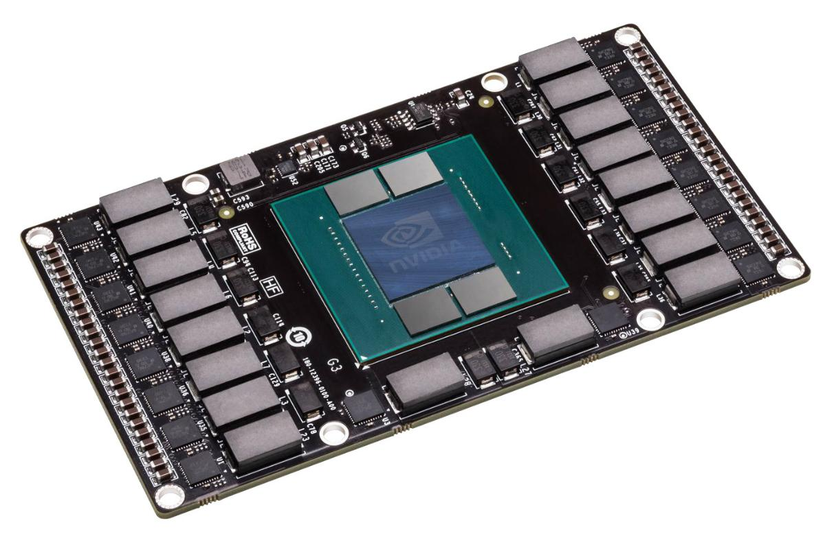
Current Trend of Computer Systems
Multi- or Many-core Processors
- Embedding multiple cores in one CPU
Complex microarchitecture
- Out-of-order execution, branch predictor, memory prefetcher, etc..
Accelerators
- GPUs, FPGAs, etc..
- Application specific designs
Novel architectures
- Dark silicon, 3D-stacking, neuromorphic computing, quantum, etc..

Slide 17
Metrics: How Do We Evaluate a System?
Performance (speed)
Response time (Latency):
How long it takes to do a task
Throughput :
Total work done per unit time
Power efficiency
How much power it consumes to do a task
Cost

Slide 18
What Determines Performance?
Algorithm
Determines number of operations executed
Programming language, compiler, architecture
Determine number of machine instructions executed per operation
Processor and memory system
Determine how fast instructions are executed
I/O system (including OS)
Determines how fast I/O operations are executed

Slide 19
Relative Performance
Define Performance = 1/Execution Time
“X is n times faster than Y”
Example: time taken to run a program -- 10s on a computer A, 15s on computer B
Execution Time_{B} / Execution Time_{A} = 15s / 10s = 1.5
A is 1.5 times faster than B.

Slide 20
Measuring Execution Time
Elapsed time
Total response time, including all aspects
Processing, I/O, OS overhead, idle time
Determines system performance
CPU time
Time spent processing a given job on CPU
Discounts I/O time, other jobs’ shares
Estimating CPU time is relatively easy based on the number of lines of code and processing speed of the CPU

Slide 21
Conclusion Time
Why do we need multi-core processors to keep the Moore’s Law alive?
Adding transistors no longer works
How do we evaluate a system?
Performance
Power efficiency
Cost

Slide 22
Conclusion Time
Why do we use CPU time to measure the performance?
Avoid influences

Slide 23


